Slide 1
Digital Watermarking
Endre papp, Naci gunduz

Slide 2
System description
Enter message
(str)
Transform from string to binary
(toBits)
Embed
(embedBits)
Embedding Watermark

Slide 3
System description
Read the Watermarked image
Read through the pixels of the image
Convert binary values to string
Recover Watermark

Slide 4
Security
In our opinion the system ca not be called secure because averaging the pixel values of two copies of the image watermarked with two different watermarks removes the watermark
To support our opinion we implemented the test in MatLab
We tested different size images and different length payloads

Slide 5
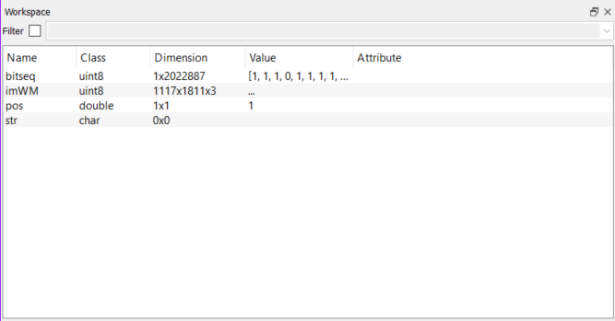
Security
Watermark removed

Slide 6
Robustness
Based on the transformations we have discussed in the lectures we have tested the robustness of the watermarking system for the following transformations
JPEG compression
Cropping
Stirmark Attack
Average filtering
Noise addition

Slide 7
Jpeg Compression

